Slide 1
Customer Conversion Prediction

Slide 2
Problem Statement
Notes:
We are working for a new-age insurance company and employ multiple outreach plans to sell term insurance to your customers. Telephonic marketing campaigns still remain one of the most effective way to reach out to people however they incur a lot of cost. Hence, it is important to identify the customers that are most likely to convert beforehand so that they can be specifically targeted via call. We are given the historical marketing data of the insurance company and are required to build a ML model that will predict if a client will subscribe to the insurance.

Slide 3
Features
age
job
marital
educational_qua
call_type
day
mon
dur
num_calls
prev_outcome
Output - y
Notes:
age (numeric)
job : type of job
marital : marital status
educational_qual : education status
call_type : contact communication type
day: last contact day of the month (numeric)
mon: last contact month of year
dur: last contact duration, in seconds (numeric)
num_calls: number of contacts performed during this campaign and for this client
prev_outcome: outcome of the previous marketing campaign (categorical: "unknown","other","failure","success")
Output variable (desired target):
y - has the client subscribed to the insurance?

Slide 4
Data Cleaning
Notes:
We have checked , the data for null,nan values, as there no such values , we gone through each columns for data

Slide 5
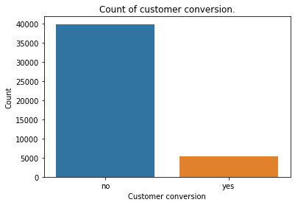
Exploration Data Analysis
Notes:
This plot shows our problem statement is a imbalanced distribution.
1)The customers getting an insurance is very low compared to the person rejecting it.
We got four numeric features such as
Age
Day
Number of calls
Call duration

Slide 6
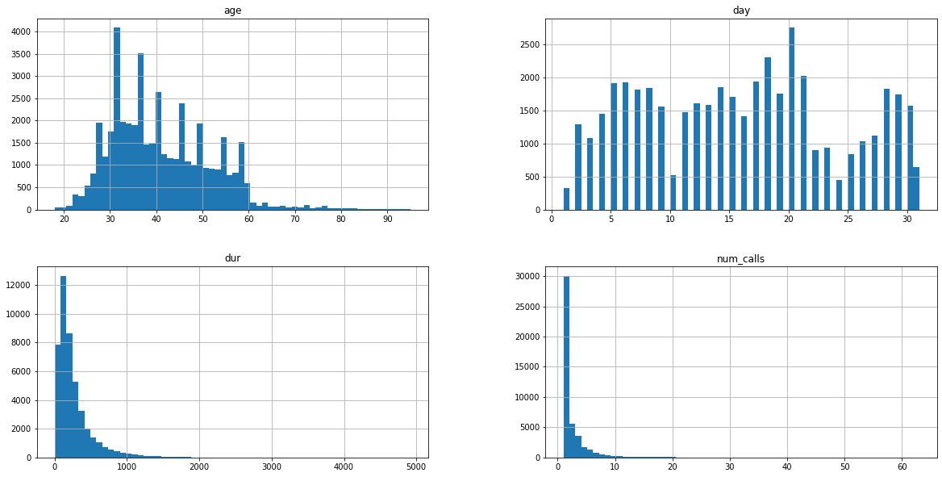
Notes:
This are graphs for each numeric feature in histogram
For each we have gone into detail as how it is effect the target outcome

Slide 7
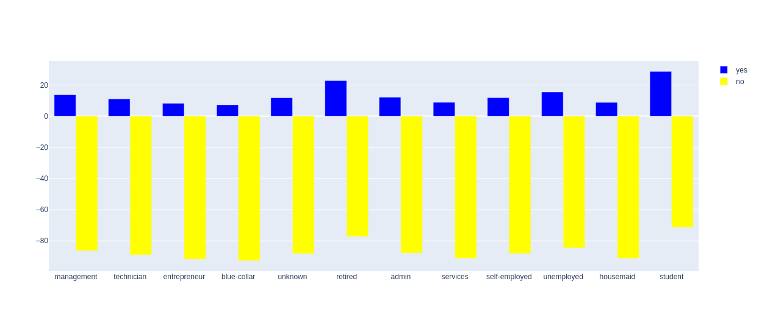
Job type vs Target
Notes:
Students and Retired persons are more likely to get an insurance comparing other professions.

Slide 8
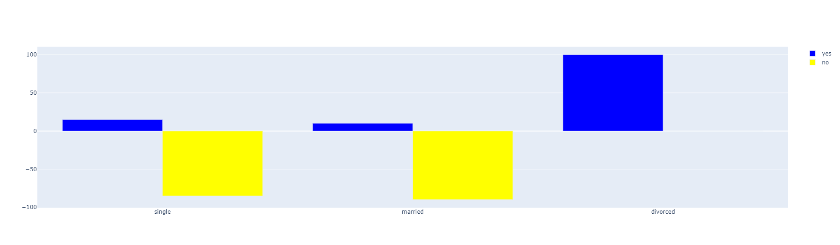
Marital status vs Target
Notes:
The people under Divorce are more likely to get an insurance followed by Singles.

Slide 9
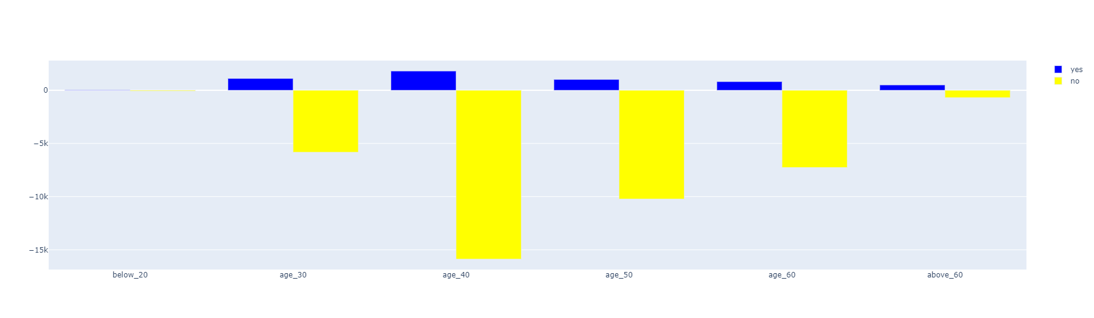
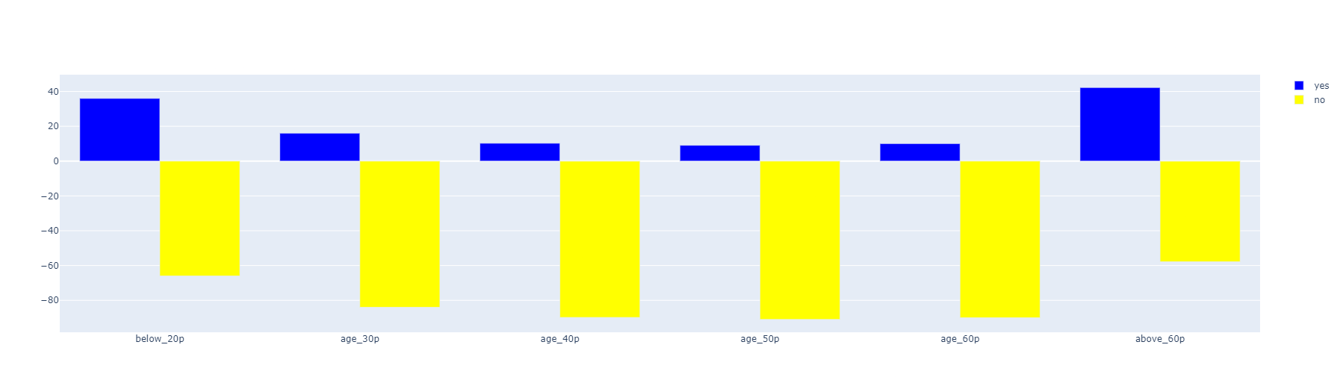
Age vs Target
Notes:
The Age group is analysed by dividing them into six .
1)People falling under age group 20 are more likely to get insured.
2)People above age 60 are more likely to get insured.
3)There is sudden rise in a person likely to get insured after age 55, Clients should concentrate this category to pull them into insurance.

Slide 10
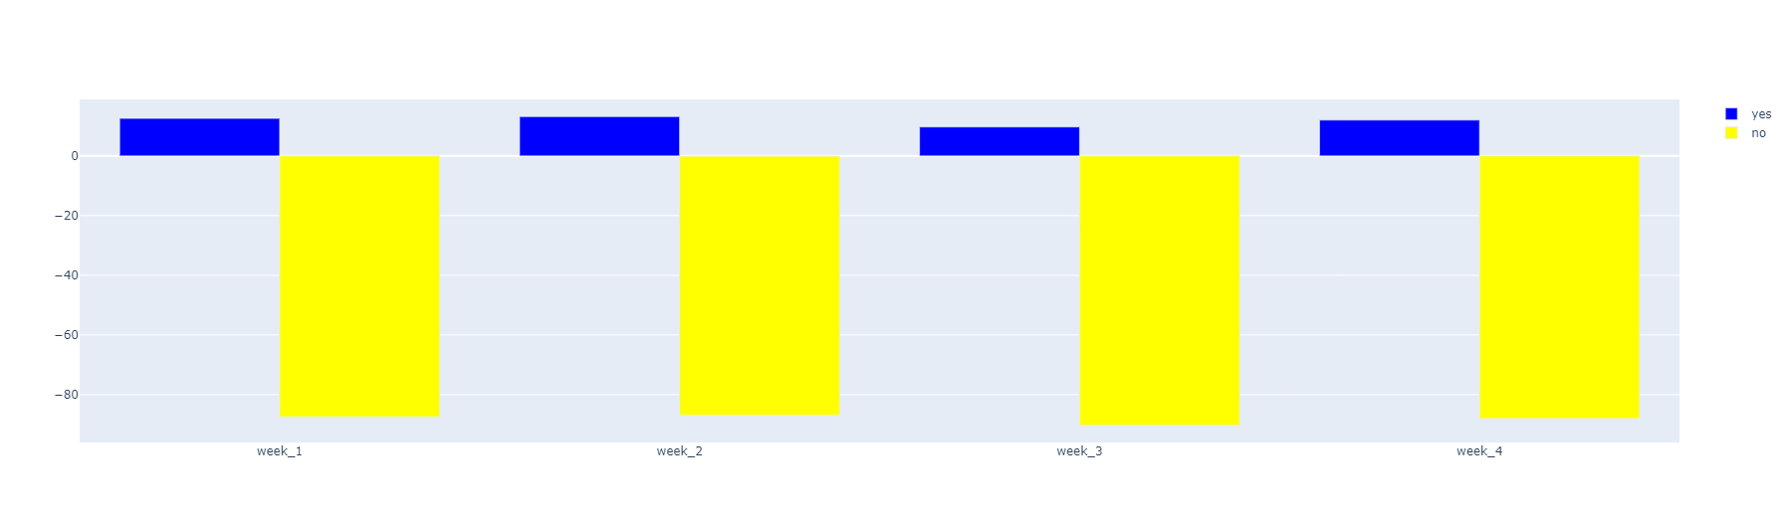
Week of the Month vs Target
Notes:
This the ratio of acceptance of insurance is considerably high in second week and goes risky in third week.

Slide 11
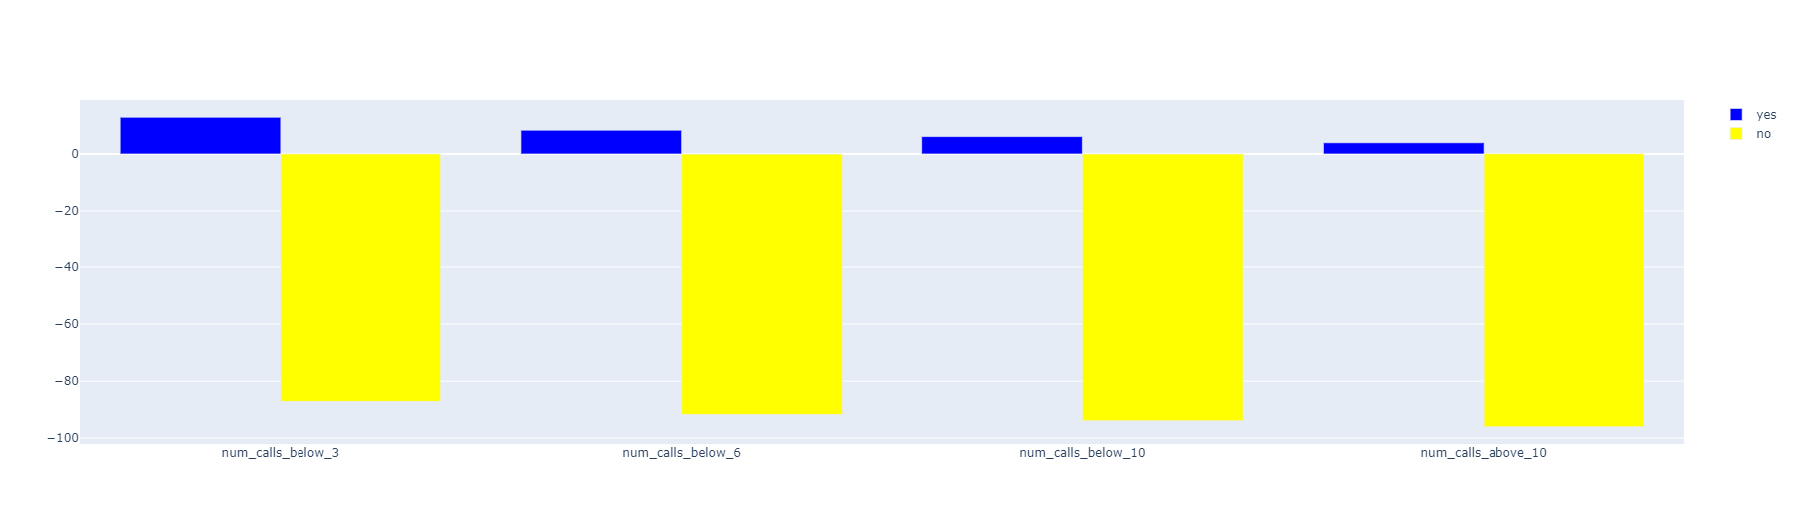
Number of calls
Notes:
We can identify a potential customer with first 5 calls ant it can be limited after 10.

Slide 12
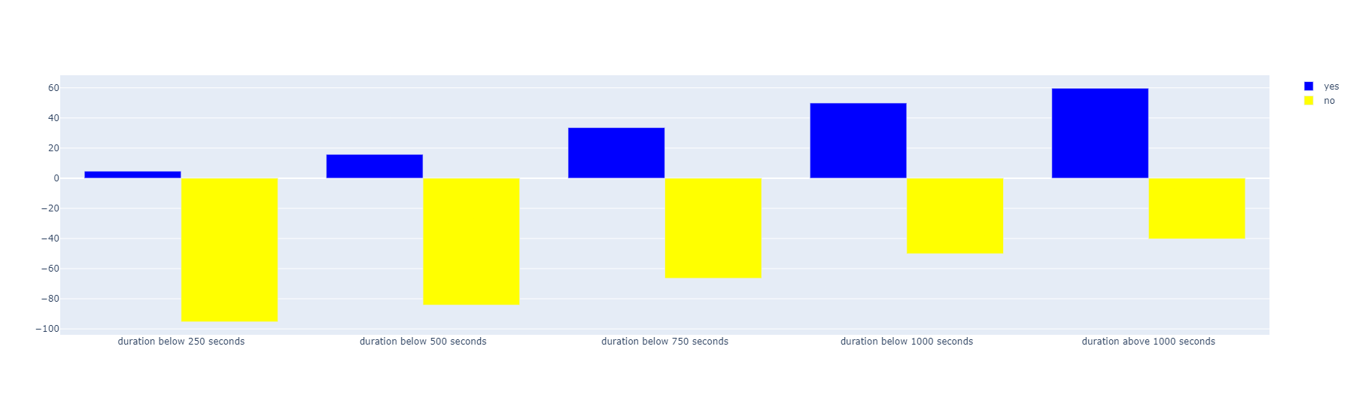
Duration of calls
Notes:
With increase in Duration, the chances of getting an insurance also increases.

Slide 13
Models with AUROC Score
Decision Tree Classifier (0.69)
Random Forest Classifier (0.66)
KNN classifier (0.77)
Naive Bayes Classifier (0.68)
Logistic Regression (0.85)
XGBoost Classifier (0.70)
Notes:
From the above list of classification models ,the best model for our problem is “Logistic Regression” which has the highest AUROC score “0.86”.

Slide 14
Evaluation metrics
F1_score
Accuracy score
AUC score
Notes:
Since we have imbalanced dataset ,among the above evaluation metrics, AUROC perform best in evaluating the model.

Slide 15
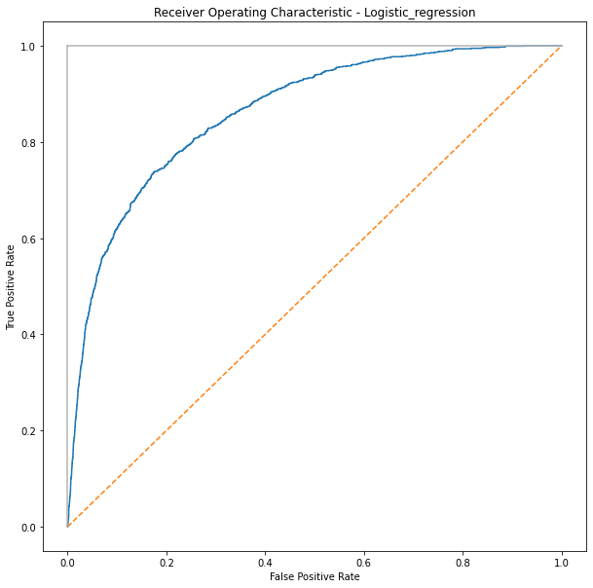
ROC curve for Logistic Regression
AUROC: 0.85

Slide 16
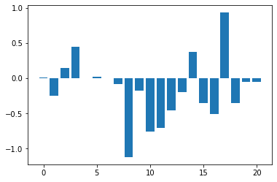
Important Features
Feature17: Student 0.932
Feature3: Call_type 0.476
Feature14: Retired 0.370
Feature2: Marital 0.144
Feature5: Month 0.022
Feature0: Age 0.013
Feature6: Duration of Calls 0.004
Feature8: Previous Outcome -1.122
Feature10: Blue-Collar -0.763
Feature11: Entrepreneur -0.712
Notes:
From the above graph, we can find the important features that contribute towards price are Student,Retired,marital.

Slide 17
Thank you

